Slide 1
Introduction to Navigator
CMPS 101
Michael Dempewolf, MIT
Clarke University
August 27, 2019

Slide 2
Agenda
Introduction
Rules of Engagement
Get to Know One Another
Syllabus
Expectations
  Student
  Teacher
Questions / Discussion

Slide 3
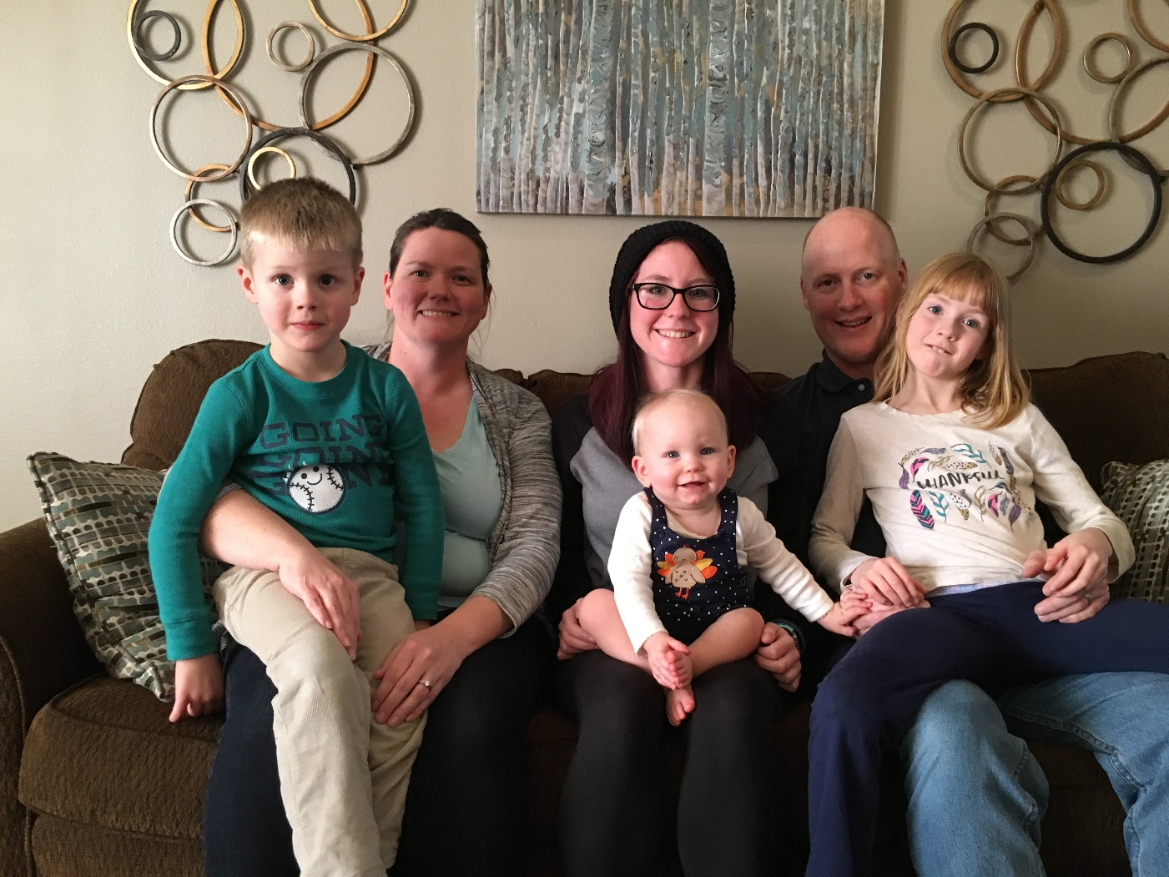
About Me
Krisy
Me
Ryan
Adrienne
Penelope
Claire
Notes:
Who I am.
My Family
Where I live
Where I work
My work history (as it relates to the topic)
My Education and history of teaching
Go Around the Room:
Name, Year in College, What do you want to do when you graduate and/or your areas of interest/passion

Slide 4
About Me (cont)
5th Year at Clarke University
20+ years experience in Software Industry
  Head of Product Development @ Cartegraph
  Programming & Software Engineering are my passions!
Major in the Iowa National Guard
  Multiple deployments
  Commander for the Iowa City Detachment

Slide 5
About Me (cont)
12+ Programming Languages
  C#, C++, C, JavaScript, HTML, CSS, Visual Basic, Xamarin
  Java, COBOL, Pascal, Fortran
  LISP, F#, Machine Language
Interests/Passions
  Programming
  Running, hiking, baseball, football, skiing
  Reading & writing (sci-fi)
  Computer Games (monthly LAN parties)

Slide 6
Rules of Engagement
Respect everyone
Turn off/Silence Cell Phones
Turn off laptops, tablets (unless taking notes)
Remove any other distractions
Ask questions, share experiences, share insights, challenge assumptions
Learn something, anything!
Notes:
Respect Everyone:
I promise to listen to you and give you my full attention. I ask the same respect from you. And I ask you share that same respect with each other. We are all life learners. We will treat each other as the professionals we are or we want to be.
Turn Off/Silence Cell Phones:
To achieve this, please silence your cell phones. Even better turn them off so the vibration does distract you. If you have to take a call or answer a text, I ask you please leave so as not to distract others who are here to learn.
Ask Questions, share experiences, share insights. Challenge assumptions:
Learn something, anything!
You are investing a good portion of your time – get something out of it
Let me know at the end if you did not learn anything at all. I make it my personal responsibility to make certain I share some new knowledge, some new perspective, or spark a passion or an idea.

Slide 7
Get to Know One Another
Things to share with everyone:
  Name
  What you plan on doing with your degree
  Where do you work (if applicable)?
  One true statement about you
  One false statement about you (class must guess which is true and which is false)

Slide 8
Syllabus
You can find the syllabus online
Recommend keeping a copy for reference
  Contains rubrics for your grade
Times/Topics may change as needed
Consult Moodle for due dates

Slide 9
Expectations
Student
  Engage & Participate
  Be Respectful of each other
    Cell Phone & other distractions
  Submit homework on time
  Communicate
  Ask questions!
  Learn something!

Slide 10
Expectations (cont.)
Teacher
  Be Respectful to you
    Cell Phone silenced
    100% my attention
  Grade in a timely manner
    Generally within 2 school days
  Present material in class & post on Moodle
  Availability (office hours, email, cell phone)
  Share my experiences
  Humor!

Slide 11

Questions?

